Slide 1

Data Communication and Networks
CS-328
Chapter 1. Introduction
Week 02
Instructors
Waleej Haider (Sec A, B, E)
Razia Nisar Noorani (Sec C & D)
Notes:
1.#

Slide 2
Objectives
Describe the basic and hybrid LAN physical topologies, and their uses, advantages and disadvantages
Describe the backbone structures that form the foundation for most LANs
Describe Internet, Internet Protocols

Slide 3
Simple Physical Topologies
Physical topology: physical layout of nodes on a network
Three fundamental shapes:
  Bus
  Ring
  Star
May create hybrid topologies
Topology integral to type of network, cabling infrastructure, and transmission media used

Slide 4
Bus
Single cable connects all network nodes without intervening connectivity devices
Devices share responsibility for getting data from one point to another
Terminators stop signals after reaching end of wire
  Prevent signal bounce
Inexpensive, not very scalable
Difficult to troubleshoot, not fault-tolerant

Slide 5
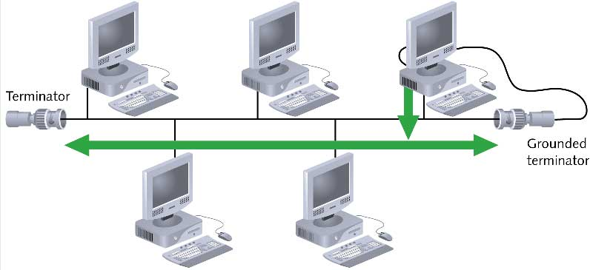
Bus (continued)

Slide 6
Advantages & Disadvantages of Bus Topology
Advantages
Works well for small networks
Relatively inexpensive to implement
Easy to add to it
Disadvantages
Management costs can be high
Potential for congestion with network traffic

Slide 7
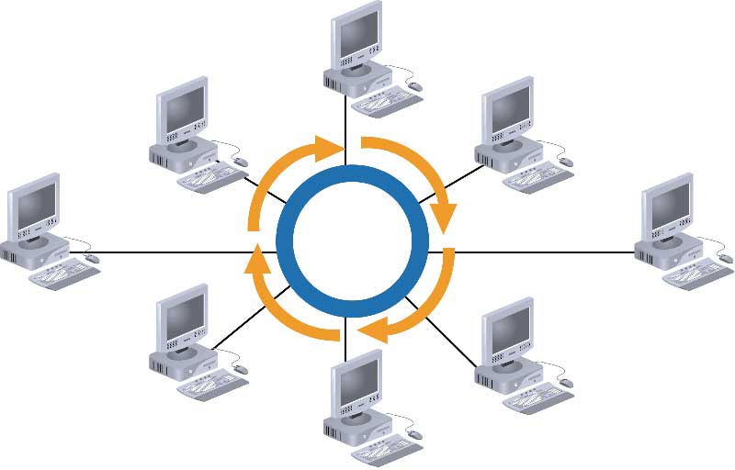
Ring

Slide 8
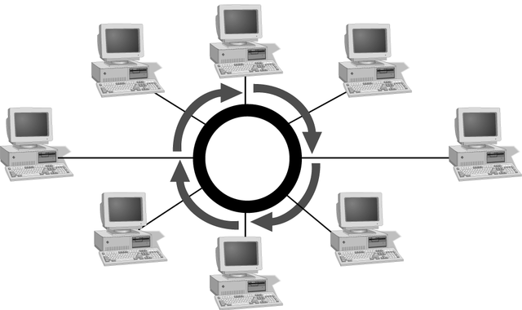
Simple Physical Topologies
Ring topology
  Each node is connected to the two nearest nodes so the entire network forms a circle
  One method for passing data on ring networks is token passing
Active topology
  Each workstation transmits data

Slide 9
Advantages of Ring Topology
Easier to manage; easier to locate a defective node or cable problem
Well-suited for transmitting signals over long distances on a LAN
Handles high-volume network traffic
Enables reliable communication

Slide 10
Disadvantages of
Ring Topology
Expensive
Requires more cable and network equipment at the start
Not used as widely as bus topology
  Fewer equipment options
  Fewer options for expansion to high-speed communication

Slide 11
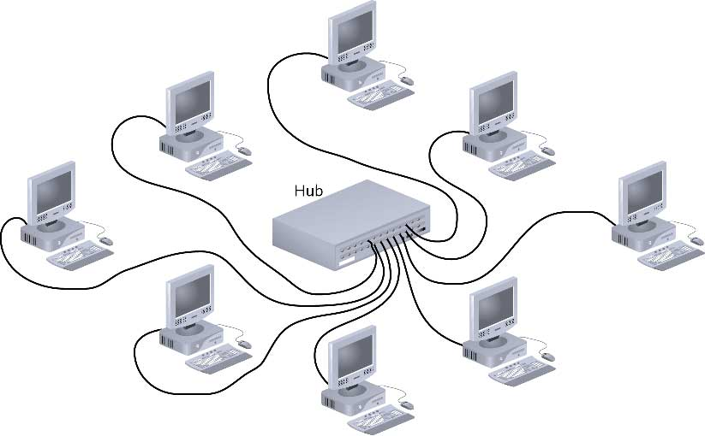
Star

Slide 12
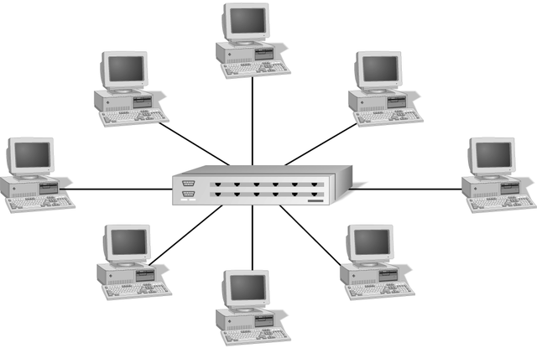
Simple Physical Topologies
Star topology
  Every node on the network is connected through a central device

Slide 13
Star (continued)
Any single cable connects only two devices
  Cabling problems affect two nodes at most
Requires more cabling than ring or bus networks
  More fault-tolerant
Easily moved, isolated, or interconnected with other networks
  Scalable
Supports max of 1024 addressable nodes on logical network

Slide 14
Advantages & Disadvantages of Star Topology
Advantages
Good option for modern networks
Low startup costs
Easy to manage
Offers opportunities for expansion
Most popular topology in use; wide variety of equipment available
Disadvantages
Hub is a single point of failure
Requires more cable than the bus

Slide 15
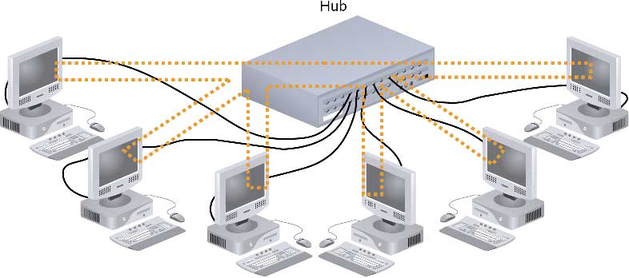
Hybrid Physical Topologies:
Star-Wired Ring

Slide 16
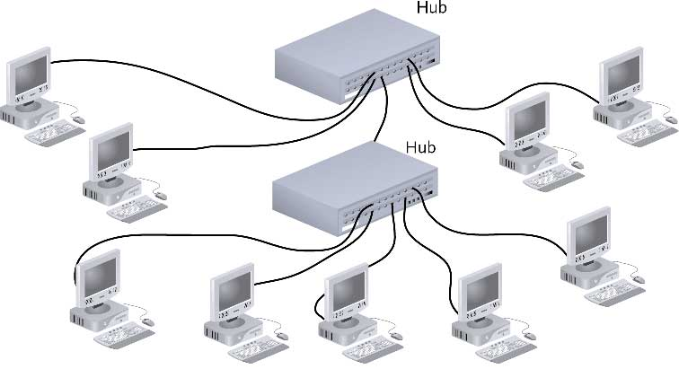
Star-Wired Bus

Slide 17

Mesh Topology
Advantage v. Disadvantage
Connection of telephone regional offices
1.<number>
Notes:
1.#

Slide 18
Backbone Networks: Serial Backbone
Daisy chain: linked series of devices
  Hubs and switches often connected in daisy chain to extend a network
Hubs, gateways, routers, switches, and bridges can form part of backbone
Extent to which hubs can be connected is limited

Slide 19
Logical Topologies
Logical topology: how data is transmitted between nodes
  May not match physical topology
Bus logical topology: signals travel from one network device to all other devices on network
  Required by bus, star, star-wired physical topologies
Ring logical topology: signals follow circular path between sender and receiver
  Required by ring, star-wired ring topologies

Slide 20


Slide 21
Quiz
Name some of the Topologies
Mesh topology
Star topology
Bus topology
Ring topology
Hybrid topology
1.<number>
Notes:
1.#

Slide 22

Which Topology ?
1.<number>
Notes:
1.#

Slide 23

Which Topology ?
1.<number>
Notes:
1.#

Slide 24

Which Topology ?
1.<number>
Notes:
1.#

Slide 25

Which Topology ?
1.<number>
Notes:
1.#

Slide 26
The Internet
The Internet has revolutionized many aspects of our daily lives. It has affected the way we do business as well as the way we spend our leisure time. The Internet is a communication system that has brought a wealth of information to our fingertips and organized it for our use.
1.<number>
Notes:
1.#

Slide 27
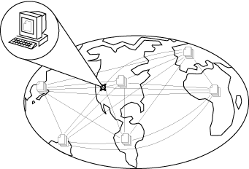
What Is the Internet?
A network of networks, joining many government, university and private computers together and providing an infrastructure for the use of E-mail, bulletin boards, file archives, hypertext documents, databases and other computational resources
The vast collection of computer networks which form and act as a single huge network for transport of data and messages across distances which can be anywhere from the same office to anywhere in the world.
Notes:
5

Slide 28
What is the Internet?
The largest network of networks in the world.
Uses TCP/IP protocols and packet switching .
Runs on any communications substrate.

Slide 29
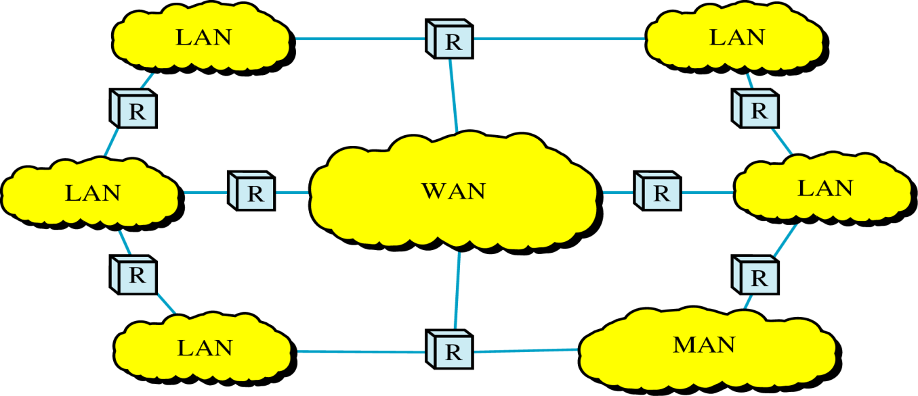
Internetwork
Internetwork (internet) : Interconnection of networks ( LANs/MANs/WANs)
The Internet:
  a specific worldwide network
  Network of networks
two or more networks are connected to one another by internetworking devices
Internetworking devices: router, gateway, etc.

Slide 30





What’s the Internet: “nuts and bolts” view
A world-wide computer network, i.e., a network that interconnects millions of computing devices throughout the world.
Mobile network
PC
Global ISP
server
wireless
laptop
Home network
cellular
handheld
e.g. desktop PCs, Unix-based workstations, PDAs, TVs, mobile computers, cell phones, automobiles etc.
Regional ISP
access
points
Institutional network
wired
links
router

Slide 31
What’s the Internet: “nuts and bolts” view
hosts = end systems are computers connected to the internet
  running network apps
End systems are connected by communication links
  Fiber optics, coaxial cable, copper, radio, satellite
  Different links can transmit data at different rates known as transmission rate(bits/sec) = bandwidth

Slide 32
What’s the Internet: “nuts and bolts” view
protocols control sending, receiving of msgs
  e.g., TCP, IP, HTTP, Skype, Ethernet
Internet: “network of networks”
  loosely hierarchical
  public Internet versus private intranet
Internet standards
  RFC: Request for comments
  IETF: Internet Engineering Task Force
Mobile network
Global ISP
Home network
Regional ISP
Institutional network

Slide 33
What’s the Internet: a service view
communication infrastructure enables distributed applications:
  Web, VoIP, email, games, e-commerce, file sharing
communication services provided to apps:
  reliable data delivery from source to destination
  “best effort” (unreliable) data delivery

Slide 34

Internetwork Example
There are 3 entities (2 LANs and 1 president office)
For this heterogeneous network following are required:
  One switched WAN has been leased (country wide telephone network)
  3 point-to-point WANs required to connect LANs to switched WAN

Slide 35

Internet Today
ISPs (Internet service providers) are local ISPs to provide direct service to the end users
RISPs (Regional ISPs) are mostly city wide ISPs
NISP (National ISP) is mostly country wide ISP
NAP (network access point) is a third party to connect all NISPs

Slide 36
PROTOCOLS AND STANDARDS
Protocols
  A set of rules to define
    What is communicated
    How it is communicated
    When it is communicated
Standards
  To guarantee national/international interoperatibility of data and telecommunication technology
  Regardless of equipment manufacturers
  ISO, ITU, ANSI, IEEE, …
  Internet standards are maintained by IETF for publishing RFC (Request for Comments)
    http://www.ietf.org/rfc.html
1.<number>
Notes:
1.#

Slide 37
Protocol
Network protocols are typically created according to industry standard by various networking or information technology organizations.
The following groups have defined and published different network protocols:
The Institute of Electrical and Electronics Engineers (IEEE)
The Internet Engineering Task Force (IETF)
The International Organization for Standardization (ISO)
The International Telecommunications Union (ITU)
The World Wide Web Consortium (W3C)
1.<number>

Slide 38
What’s a protocol?
human protocols:
“what’s the time?”
“I have a question”
Introductions
… specific msgs sent
… specific actions taken when msgs received, or other events
network protocols:
machines rather than humans
all communication activity in Internet governed by protocols
A protocol defines the format and the order of messages exchanged between two or more communicating entities, as well as the actions taken on the transmission and/or receipt of a message or other event.

Slide 39
4. Protocols
Key elements of a protocol
  Syntax: Structure or format of data
  Semantics: meaning of each section of bits in the structure
  Timing: when data should be sent and how fast they can be sent

Slide 40


What’s a protocol?
a human protocol and a computer network protocol:
Hi
TCP connection
request
Hi
TCP connection
response
Got the
time?
Get http://www.awl.com/kurose-ross
2:00
<file>
time

Slide 41
End of Week 02
1.<number>

